Slide 1
REVIEW PREDICTION
SUBMITTED BY
JUHI MISHRA

Slide 2
PROBLEM STATEMENT AND UNDERSTANDING
This project is text based for which we need to solve using NLP and NLP is one of the NLTK tool which is used to solve basically natural language processing issues. NLP is the branch of artificial intelligence . Here we are working for one of our client which is Flipkart who has a website where people write different reviews for technical products. Here new feature being added where customer can not only write their review but also can add star for product how they are and how much star could be given to that particular product. Total 5 ratings are available which is 1 star, 2 stars, 3 stars, 4 stars and 5 stars. Here we have to predict rating based on reviews which was written in past and they don’t have rating available. So here as we do have two columns which is rating and review , so this problem statement is text based where a computer have to understand the text and need to predict rating accordingly. As a data scientist we need to find the solution for the same. For any text based problem statement NLP works best as it makes computer understand the natural language and can then accurately extract information and insights contained in the document as well as categorise and organise the documents themselves. Here using NLP will preprocess the data and will later choose ML algorithm for making prediction based on previous dataset. This is a classification based problem statement as in target we do have discrete values which are ratings. For which we need to choose classification algorithms and build model accordingly.

Slide 3
EXPLANATORY DETAILED ANALYSIS - EDA
This project is text based for which we need to solve using NLP and NLP is one of the NLTK tool which is used to solve basically natural language processing issues. NLP is the branch of artificial intelligence concerned with giving computers the ability to understand text and spoken words in much the same way human beings can. Here we are suppose to predict rating based on review given by customers on any of the particular product. To understand text data we need to do the preprocessing using NLP. After preprocessing done need to use ML algorithm so that we can predict the rating on any particular review.we are working for one of our client which is Flipkart who has a website where people write different reviews for technical products. Here new feature being added where customer can not only write their review but also can add star for product how they are and how much star could be given to that particular product. Total 5 ratings are available which is 1 star, 2 stars, 3 stars, 4 stars and 5 stars. Here we have to predict rating based on reviews which was written in past and they don’t have rating available. So here as we do have two columns which is rating and review , so this problem statement is text based where a computer have to understand the text and need to predict rating accordingly. As a data scientist we need to find the solution for the same. For ant text based problem statement NLP works best as it makes computer understand the natural language and can then accurately extract information and insights contained in the document as well as categorise and organise the documents themselves. Here using NLP will preprocess the data and will later choose ML algorithm for making prediction based on previous dataset. This is a classification based problem statement as in target we do have discrete values which are ratings. For which we need to choose classification algorithms and build model accordingly.
Before preprocessing checked whether there are any missing values in any of the rows or column. There are no missing values in any of the column or rows. Datatype of both the column which is review and rating is object datatype. Then whether the problem is balanced or imbalanced using value.counts because this is classification based problem statement and for classification problem statement we have to check whether the data is balanced or not. Here the data is a balanced one so no need to preprocess for the same. All the rating are equally distributed which is 3,456 each for rating 1,2,3,4 and 5. This is text based problem statement where I need to use NLP approach. NLP stand for natural language preprocessing which generally understand the text or speech type of data and try to solve the same. Mathematically here I used TFIDF vectoriser to convert all string form to numerical one as computer doesn’t understand string datatype . TF-IDF stands for term frequency and inverse document frequency. Tf-idf value increases proportionally to the number of times a word appears in the document and is offset by the number of documents in the corpus that contains the word, which helps to adjust for the fact that some word appear more frequently in general. Formula for Tf-idf mentioned below :
Tf-idf
TF(t) = (Number of times term t appears in a document) / (Total number of terms in the document)
IDF(t) = log_e(Total number of documents / Number of documents with term t in it)
tf-idf(t, d) = tf(t, d) * idf(t)
Formula and mathematical approach we seen above for calculation of tf-idf where tf is used in connection with information retrieval and shows how frequently any term or word occurs in a document. While idf used to calculate the weight of rare words across all documents in the corpus.
There are lot many approaches to convert string to vector which are count vectoriser, tf-idf, word to vec(Word embedding technique). But here I used tf-idf because of more reliable result I can get using this approach here.

Slide 4
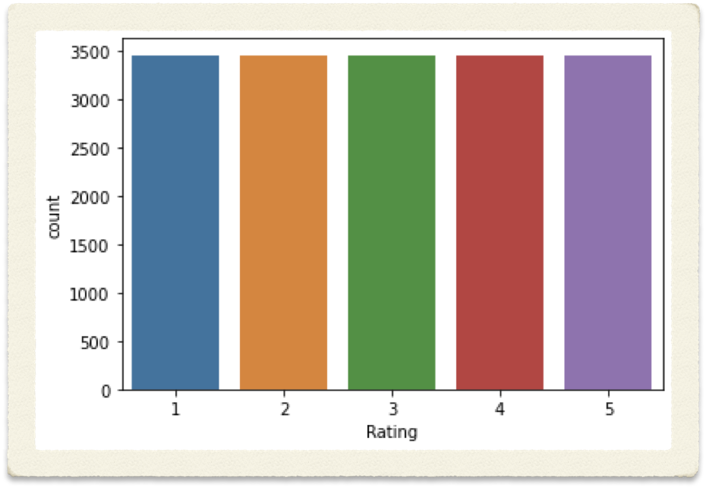
VISUALISATION ANALYSIS
Visualisation gives us more clear idea of what the information we require by it’s visual context through graph or map. It is easier to identify trends, patterns and outliers within large dataset. To have visualisation here I used matplotlib, seaborn and wordcloud as this is text based problem statement. Below we can observe that all the ratings do have equal number of
Data so we are getting all the bar plot on same label
Which is 3,456

Slide 5
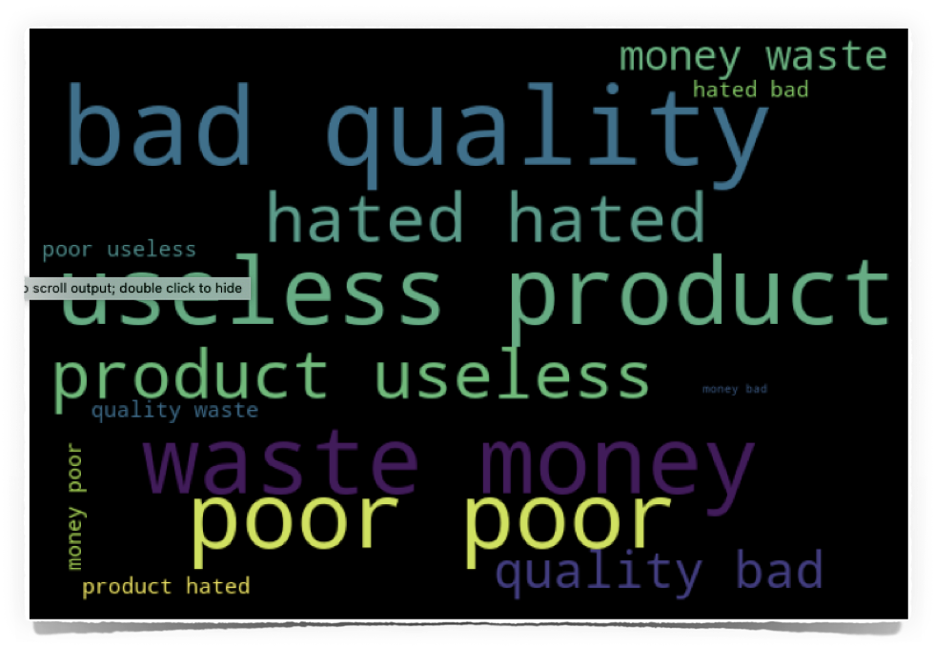
VISUALISATION ANALYSIS USING WORD CLOUD
Using word cloud we can have visualisation of which words are more important . As using this visualisation technique words which are having high value will be more visible and which are having low value will have less visibility. Here we can see that bad quality , useless product are larger in size which means these words are having high value while money poor, product hated useless all these words are too small which means they do less value in this dataset.

Slide 6
ASSUMPTION FOR COMPLETION OF PROJECT UNDERTAKEN
Data input here is Review where all the customer gives their valuable feedback based on their experience. All the reviews scrapped from Flipkart for different technical products in an excel sheet.. Here I need to predict rating based on reviews provided former. Which means using NLTK library I have to follow the NLP approach to solve this problem. Preprocessing done based on NLP approach here. Which means brought all the uppercase words to lower case to avoid noise. Then converted the words from contraction to expansion means shorten words have been expanded. Then removed multiple spaces and removed stop words. Stopwords are here not required because they do not add much value to our dataset. And by removing these we can have more important words much visible. Then lemmatised alll the words which means converting the words to their base form. Then converted all the strings to numerical form using tfidf approach as our machine algorithm doesn’t understand the string datatype . After preprocessing done used classification based algorithms to build model. This problem statement is classification based because target column were having discrete value. Before preprocessing checked whether my data is imbalanced or not as for any classification problem statement we need to check this . If the data is imbalanced one then our model performance will be hampered. So to avoid such we need to treat them using sampling method means either we need to oversample the data or under sample. But here in this dataset no such treatment was required as every rating were equal in number. Also there were no null values wither in any of the row or column.

Slide 7

MODEL BUILDING

Slide 8
ALGORITHM LIST FOR MODEL BUILDING
Data input here is Review where all the customer gives their valuable feedback based on their experience. All the reviews scrapped from Flipkart for different technical products in an excel sheet. Review . Based on problem statement selected 3 classified algorithms listed below :
1. Random Forest Classifier
2. SGD Classifier
3. LinearSVC
For evaluation selected metrics are :
1. Classification report
2. Accuracy Score
To train and test , hyper parameter tuning and for validation score import few of the algorithm from sklearn model selection . These are:
1. train_test_split
2. GridsearchCV
3. Cross Validation Score.
To scale the features used standard scaler to bring all the features to same unit with the help of which model will have better performance.

Slide 9
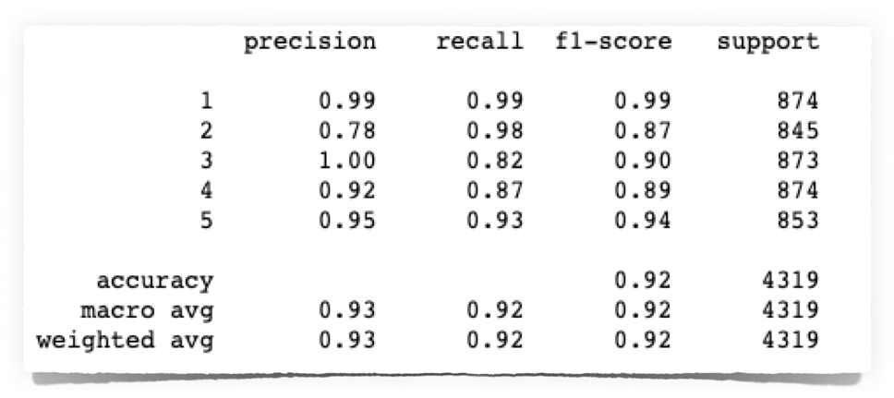
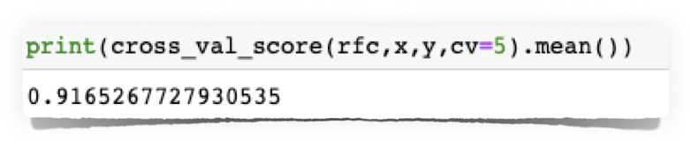

RANDOM FOREST CLASSIFIER
First classifier algorithm I used is RandomForestClassifier is an ensemble technique which consist of many decision trees and combines many classifiers to provide solutions to complex problems.This algorithm generally gives output based on the predictions of the many decision trees. Increasing the number of trees increases the precision of the outcome. It reduces the overfitting of datasets and increases precision. Below provided the snapshot of the RandomForest Classifier algorithm performance :
For rating 1 all the precision , recall and f1-score is 99% which means score for rating 1 is really good. While for Rating 2 precision score is too low which is 78% compare to recall which is 98% because of which f1 score shows 87%, as f1 score is the combination of both false positive and false negative where precision is having false positive and recall is having false negative. Formula of f1 score is 2*(precision * Recall)/Precison + Recall. Similarly for rating 3 we can see that false positive which is precision is having 100% while recall which basically have focus on false negative is 82% and the avg of both which is f1 score is 90%. In this problem statement recall score is much helpful compare to precision because here we need rating prediction and if false positive will be higher will not able to identify genuine rating of customers how many are satisfied and how many are dissatisfied. For rating 4 precision score is 92% while recall is 87% and avg of both is 89%. While for rating 5 there are not much difference between scores of precision recall and f1 score . As we can see that false positive(precision) score is 95% while false negative score (recall) is 93% . F1 score for the same is 94% which is multiplication of 2(p*r)/(p+r). Overall accuracy score we got as 92% . While cross validation score on total 5 foldings is 91.65% which is less than accuracy score .

Slide 10



SGD CLASSIFIER
Second used SGD Classifier algorithm.SGD classifier is a Linear classifier optimized by SGD. These are two different concepts. SGD is a optimisation method while Logistic regression or Linear support vector machine is a machine learning algorithm / model. Because of few downsides of Gradient Descent algorithm we use SGD. SGD randomly picks one data point from the whole data set at each iteration to reduce the computation enormously.
From above classification report we came across each rating precision, recall, f1 and accuracy score. Here rating 1 is having all 99% means false positive, false negative and average of all which is f1 score are equal. Having false positive report high for this problem statement will not give us accurate report . Because if will get high false positive then most of the rating will be shown as positive result which will not be helpful in identifying the dissatisfied customer. Rating 2 precision score is 99% (false positive) and recall is 82% (false negative) . Overall combination of both which is f1 score is 90%. For rating 3 precision score is 79% while recall is pretty high which 98% means here the possibility to have false negative is high. And so the f1 score affected and showing including both false positive and negative report is 87%. For rating 4 precision score is 91% while recall score is 88% while f1 score is 89%. For rating 5 precision score is 97% while recall is 93% and f1 score is 95%. Over all we can say that rating 3 is having huge difference between precision and recall in which recall score is high which means possibility of getting false negative options will be high. Overall Rating 5 doesn’t have much fluctuation in score. While overall accuracy score is 92% which is almost equal to random forest classifier. While CV score for this algorithm is 91.97% . Not much difference between accuracy score which is our classification metrics and CV score. Only 0.25% difference we observe.

Slide 11


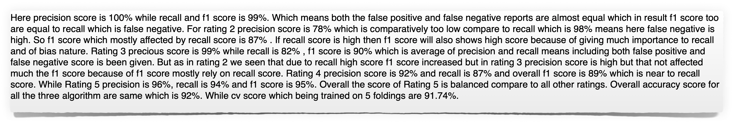
LINEAR SVC
Third algorithm used is Linear SVC. Objective of this algorithm is to fit to the data that we provide, returning a best fit line which is hyperplane that decides or categorise our data. Below is the snapshot of classification report for Linear SVC performance on this particular dataset:

Slide 12

GRID SEARCH CV (HYPERPARAMETER TUNING)
Over all the difference between accuracy score and cv score is less for SGD so did hyperparameter tuning on the same using GridSearchCV. Usually we do Hyperparameter tuning to improve the score if possible.
Did hyperparameter using 4 parameters which is penalty, alpha, l1 ratio and max iteration. Provided to each parameter 3 values on which I was suppose to train the model. One by one using each value the model get trained and will provide accuracy score. After training got best parameters and used the same on my best performing algorithm which is SGD and predicted the score . As a result got 91.75% . Means score has not improved . Even 0.25% score been reduced. Here might be chance that if we increase the parameter and values inside that we can have much better score.

Slide 13
CONCLUSION
Working for a client who has a website where people write different reviews for technical products. Client now added a new feature to the website where reviewer not only can write their reviews but also can add stars for a particular product. Rating which they are suppose to give is out of 5 and there are 5 options available which is 1 star, 2 star, 3 star, 4 star and 5 star. Here what our client requirement is to predict ratings for those reviews written in past and they don’t have a rating. So here as data scientist we need build an application which can predict rating by seeing the review. For this first we needed the data which I scrapped from Flipkart site for different technical products. And tried to have equal number of data for each review to balance the dataset. If the dataset is not balanced model performance will be affected and the score will not be accurate as expected. Once scrapped all the required data saved the same to excel format. Now to build the model import dataset using pandas library into Jupiter notebook. Total number of rows available here is 17,275 and column is 2 . Using info method checked datatype for both the column. Rating datatype here is integer while review is having object form means string datatype. There are no missing values either in any of the column or rows. This is classification based problem statement as in target column there are discrete values means which are fixed one. For preprocessing used NLTK (Natural Language Tool Kit) library from where import NLP (Natural Language processing) Which makes computer understand the text data in natural way . Interpretation of text or speech language become easier for computer by using natural language processing as it tries to understand like how we human think. Coming to preprocessing converted all the uppercase word to lowercase , using contractions to expansion expanded the short written words such as “don’t” to “do not” , then removed all the punctuations and special character which were present in sentence, removed multiple spaces, then removed stop words . These words are frequently occurring words but do have less contribution. So to avoid noise removing such words.

Slide 14
Then tokenised all the words means breaking sentence into words which is known as tokens. After tokenisation lemmatisation done on dataset . Lemmatization also known as lemma convert all the words to it’s base form means “Run, Ran, Running all will be converted to base word which is Run”. After lemmatisation using Tfidf (Term frequency - inverse document frequency) which is one of the statistical measure that evaluated how relevant a word is to document in a collection of documents. Term frequency calculated of a word in a document while inverse frequency calculates of the word across a set of documents. Which means how common or rare a word is in the entire document set. Tf-Idf formula mentioned below :
Tf-idf
TF(t) = (Number of times term t appears in a document) / (Total number of terms in the document)
IDF(t) = log_e(Total number of documents / Number of documents with term t in it)
tf-idf(t, d) = tf(t, d) * idf(t)
will be converted to base . Using this transformed all the strings to numbers which our machine algorithm can understand. For visualisation used word cloud to know which is more importance and this we can conclude just by looking after the image. Words which are larger and bold are caring high weightage and which are small in size will have less weightage. This gives us more clarity that on which word we need to focus more.
Once preprocessing and visualisation done separated feature and label into x and y respectively for model building. Using standard scaler scaled all the feature to bring them to same unit. After this selected three algorithm for model building and prediction. These are :
1. RandomForest Classifier
2. Linear SVC
3. SGDClassifier
And for hyper parameter tuning used GridSearchCV which helps in improving score .
Metrics used to check the score of all the models are :
1. Precision which shows false positive report
2. Recall which shows false negative report
3. F1 score which is the combination of both false positive and false negative score. Used to make balance between precision and recall.
4. Accuracy score is one metric which shows the over performance of model on a particular dataset . Means how much a particular trained dataset been understood by model and as a result shown using test dataset .

Slide 15
After evaluating all the models came across that accuracy score for all the models are same which is 92% there are difference in score we can see in precision, recall and f1. Mostly f1 score considered to be best in case of text dataset. But there are not much difference even in f1 score too which is the combination of both precision and recall. Then calculated CV score on 5 folding for each model to conclude which model is the best performing model. Even CV score was almost near to each other but with minor difference considered SGD classifier as the best performing model. Because the difference between CV and accuracy score was less for this model. Did hyperparametr tuning on SGD Classifier but score not improved. This may be because of I used here only 4 parameters and in parameter there passed 3 value each. As how many parameters we select and the value inside we give training time increases. So to avoid such selected less parameters and values. May be possibility if would have increased the parameter or values inside that score would have increased . Or if used RandomizedSearchCV or any other hyperparameter to tune the model score would have increased. Atlast saved the model and using test dataset which I passed 25% and 75% for training dataset predicted the model.

